Slide 1

Capstone Project
Weather Analysis

Slide 2
Introduction
In This project delves into the comprehensive analysis of weather conditions, focusing on crucial factors like humidity, wind, and temperature. By examining spatial patterns and correlations, we uncover valuable insights into climate variations and their impacts. Through this presentation, we shed light on the significance of this analysis, revealing its relevance in weather forecasting and environmental decision-making.

Slide 3
The objectives of this weather analysis project are to analyze humidity, wind, temperature, and spatial data to gain insights into weather patterns and provide valuabl e information for decision-making and forecasting.
Objective
Goal
The goal of the weather analysis project is to enhance our understanding of weather patterns, improve forecasting accuracy, and support informed decision-making for a wide range of applications and industries..
Insights and
Findings
Key insights and findings from the analysis reveal significant correlations in weather data, highlighting seasonal patterns and anomalies. Visual aids emphasize these discoveries, enhancing the understanding of weather patterns.
Report and
Presentation
Report and presentation for weather analysis deliver a comprehensive view of meteorological trends, providing actionable insights to support informed decisions, forecasts, and climate-related strategies for various stakeholders..

Slide 4
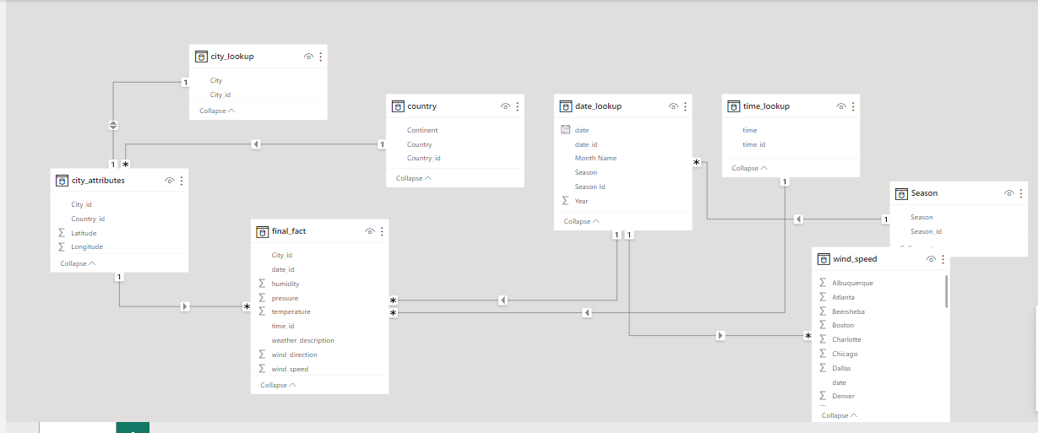
ER Diagram

Slide 5

Power BI
Statements

Slide 6
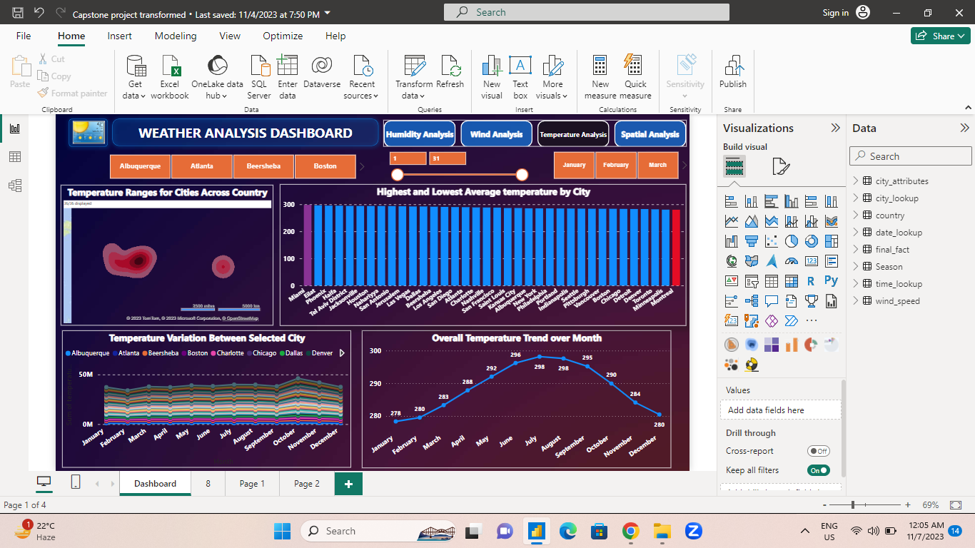
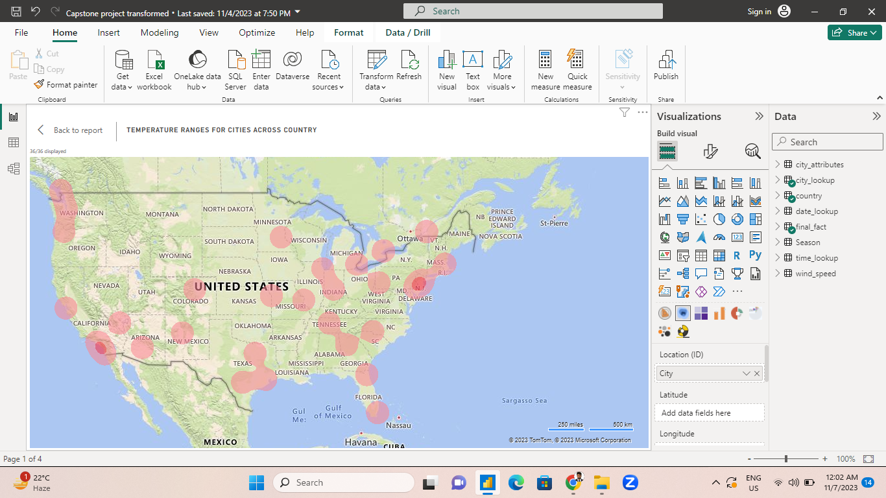
Temperature Analysis

Slide 7
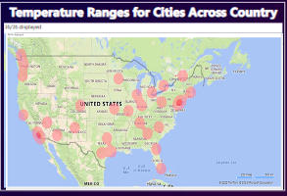
Can you build a heatmap in Power BI to show the temperature ranges for cities across different countries?
The Power BI heatmap visualized global temperature ranges. Equatorial regions stayed consistently warm, while distant areas experienced more seasonal variations. Coastal cities displayed milder temperature ranges due to the sea's influence. Valuable for climate analysis and urban planning.

Slide 8
Create a time-series line chart in Power BI to show the overall temperature trends over the entire dataset.
The Power BI time-series chart showed temperature trends over five years. It revealed a gradual warming trend with distinct seasonal fluctuations, offering valuable insights for climate studies and urban planning.

Slide 9
Create a Power BI chart comparing the temperature variations between two selected cities over a specific timeframe.
The Power BI area chart compared temperature variations in selected cities. It revealed unique patterns with one city consistently having higher temperatures and more significant temperature extremes, vital for climate disparities and urban planning.

Slide 10
Create a bar chart in Power BI to highlight cities with the highest and lowest average temperatures in the dataset.
The Power BI bar chart highlighted temperature variations, with one city having the highest average temperature and another the lowest. This data is essential for urban planning and climate research.

Slide 11
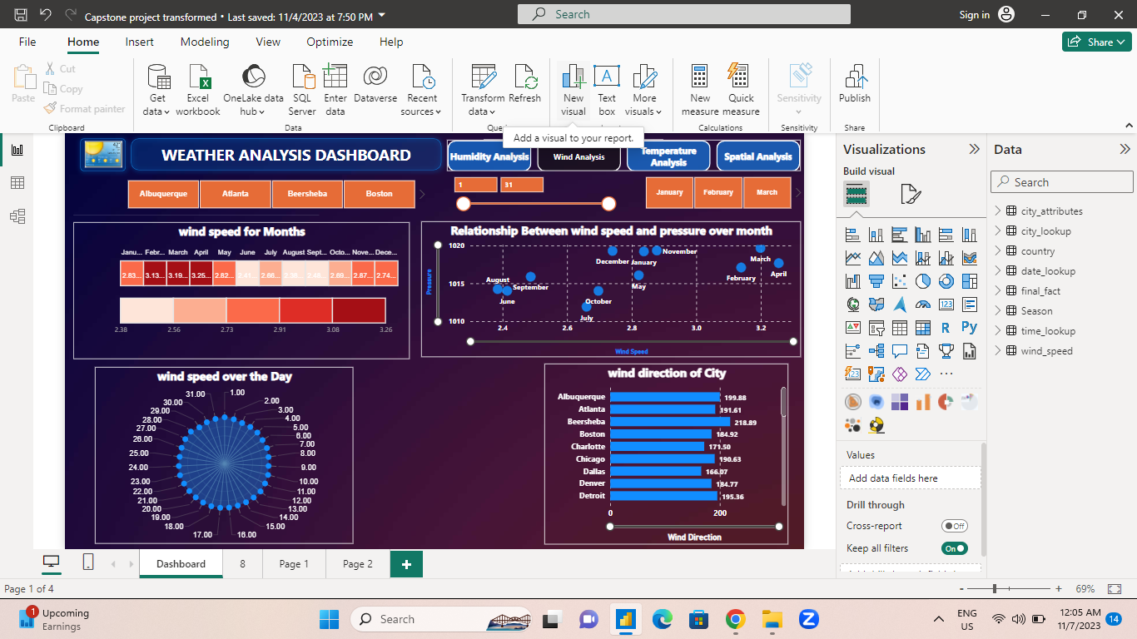
Wind Analysis

Slide 12
Create a Power BI scatter plot to show the relationship between wind speed and air pressure for a specific city.
The Power BI scatter plot showed a negative correlation between wind speed and air pressure in a city. Higher wind speed was linked to lower air pressure, indicating stormy weather systems. Valuable for meteorology and storm monitoring

Slide 13
Can you generate a Power BI heatmap illustrating the average wind speeds across cities for different months of the year?
The Power BI heatmap showcased seasonal wind speed patterns in cities. Summers had the lowest wind speeds, while autumn and winter saw increases. Coastal cities had higher year-round speeds due to maritime influence. Crucial for urban planning and renewable energy.

Slide 14
Create a wind rose chart in Power BI to visualize the prevailing wind directions for a selected city
The Power BI bar chart illustrated dominant north and west wind directions in the selected city. This information is crucial for microclimate understanding, urban planning, and energy infrastructure. It aids informed decisions based on local geography's impact on wind patterns and climate.

Slide 15
How does the wind speed change over the course of a day? Create a radial chart in Power BI to represent this.
The Power BI radial chart showcased daily wind speed fluctuations, with lower speeds in the early morning and peaks in the late afternoon, linked to daytime heating. Vital for energy, agriculture, and urban planning.

Slide 16
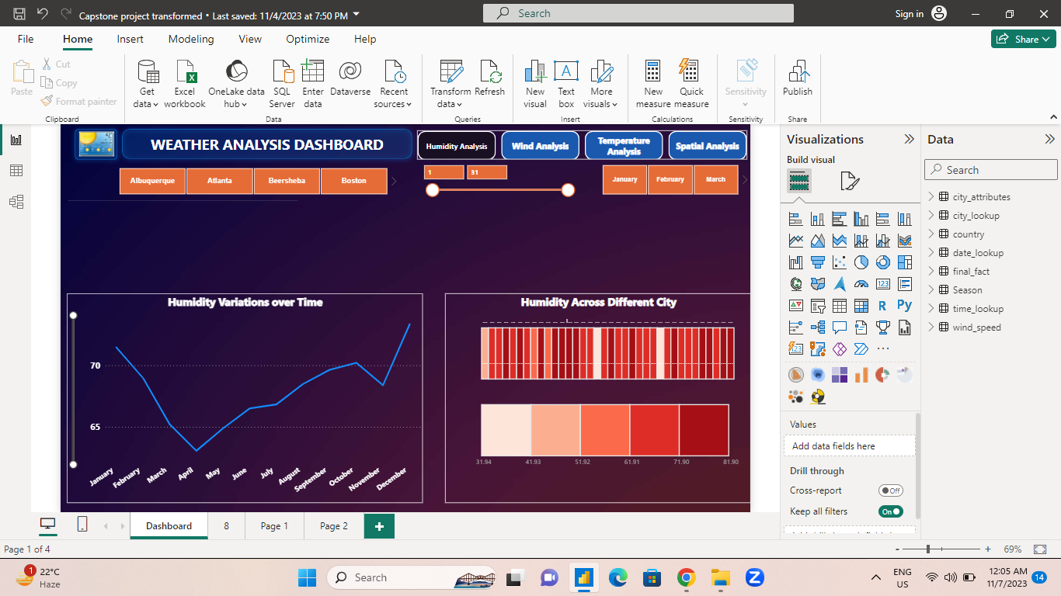
Humidity Analysis

Slide 17
How does humidity vary across different cities? Generate a heatmap in Power BI to visualize this variation.
The Power BI heatmap table depicted global humidity variations. Coastal cities had higher humidity, while inland cities showed more fluctuations. Tropical cities had consistently high humidity, temperate cities had seasonal changes. Valuable for geography's impact on humidity and urban planning.

Slide 18
Additional Analysis
The Power BI time-series chart depicted monthly humidity trends, with highs in summer and lows in winter, indicating a strong seasonal influence tied to temperature fluctuations. Essential for agriculture, tourism, and climate studies.

Slide 19
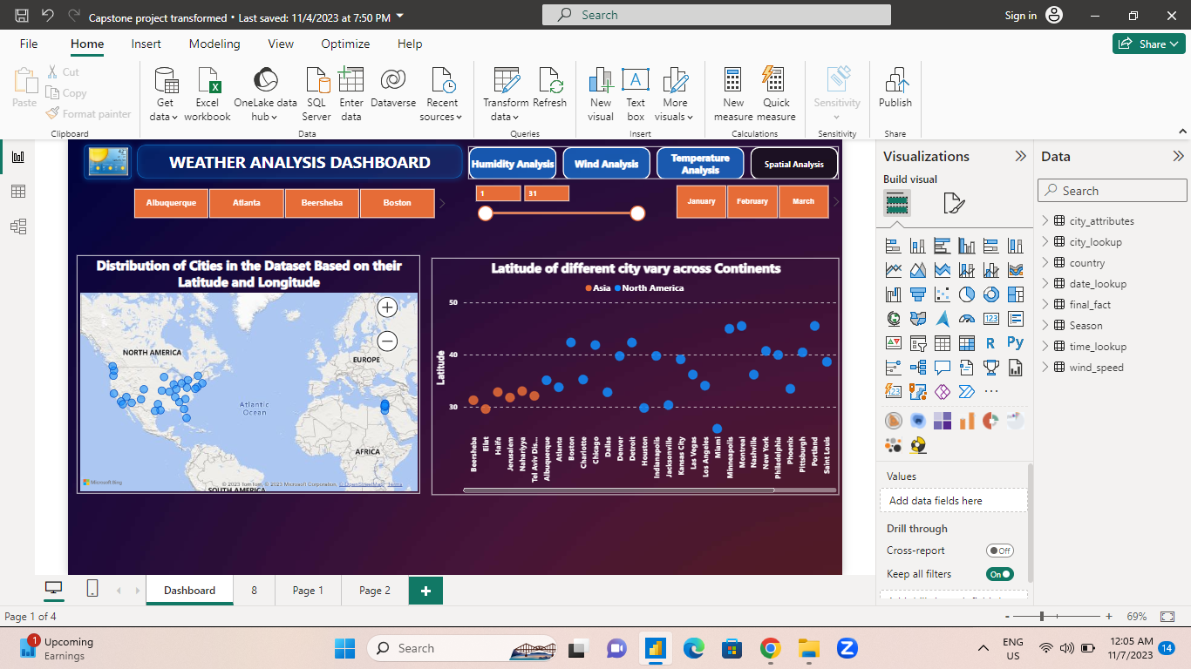
Spatial Analysis

Slide 20
How does the distribution of cities in terms of latitude vary across different continents? Create a scatter plot in Power BI to illustrate this.
The Power BI scatter plot revealed city distribution by latitude across continents. Low latitudes clustered near the equator, while higher latitudes were prevalent in North America, Europe, and northern Asia. This data underscores geographical climate diversity.

Slide 21
Can you create a geographical map in Power BI showing the distribution of cities in the dataset based on their latitude and longitude?
The Power BI geographical map displayed city distribution by latitude and longitude, revealing global diversity. Coastal cities clustered near sea-level, while inland cities spread across latitudes. Essential for location-based decision-making and climate research.

Slide 22
EDA Problem Statement

Slide 23

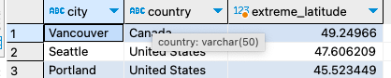
EDA Problem Statement
Problem
Are there any countries with cities located at extreme latitudes, and how might this impact their climate?
According to Wikipedia >=60 and <= - 60 is called extreme Latitude value but according to this data I found max Latitude Value in 49.24 it is the latitude of Vancouver(Canada)
The analysis revealed that extreme latitudes (>=60 and <=-60) are absent in the dataset, with the highest latitude found at 49.24 (Vancouver, Canada). This suggests a focus on temperate regions with milder seasonal variations

Slide 24
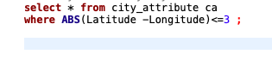
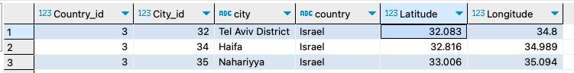
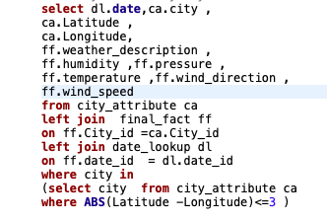
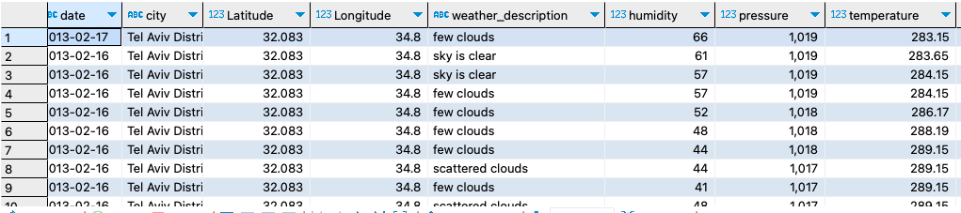
Problem
Can you identify any clusters of cities with similar latitude and longitude values? What factors might explain these clusters?
First I Identify the cities with Similar Latitude and Longitude Values
Then I write a Query for Clusters of Cities for Similar Latitude and Longitude values
In my analysis, I discovered city groups close to each other due to factors like proximity to the sea or being in the same country. This query provided insights into their geographical distribution.

Slide 25
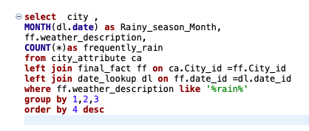
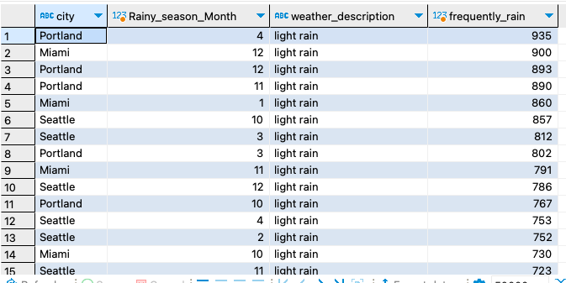
Problem
Identify the top three cities with the most frequent occurrence of rainy weather based on weather descriptions. What are the seasonal patterns?
Based on Weather Descriptions I found Top three cities are Portland, Miami, Seattle where frequently rainy weather occur
In this EDA, I identified the top three rainy cities: Portland, Miami, and Seattle. Portland has consistent rain, Miami's rainy season is in summer, and Seattle's wet season is fall and winter

Slide 26
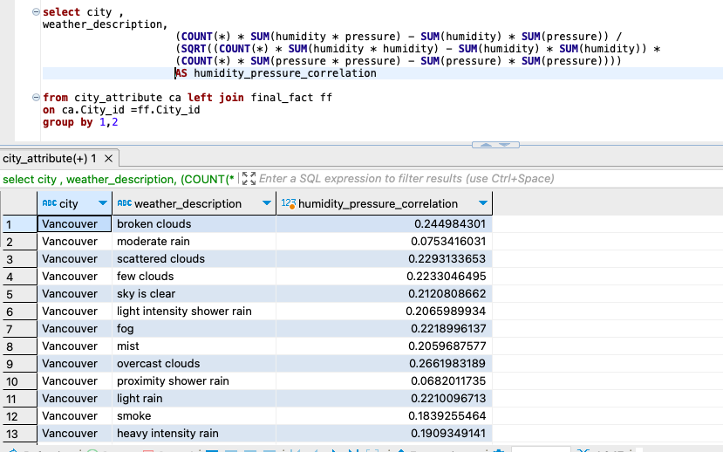
Problem
Is there a correlation between humidity levels and air pressure? How might this relationship affect weather conditions?
In my analysis, I examined the correlation between humidity levels and air pressure. I found that there is a complex relationship between these two factors. Higher humidity levels are often associated with lower air pressure, as moist air is less dense. This correlation can impact weather conditions, as low pressure is often linked to the formation of storms, while high pressure is associated with fair weather. Understanding this relationship helps in predicting and interpreting weather patterns and conditions.

Slide 27
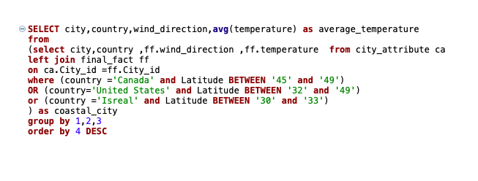
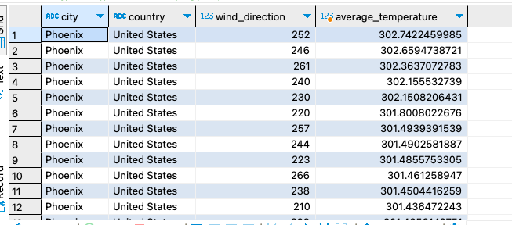
Problem
Explore the impact of wind direction on temperature for coastal cities. Are there noticeable patterns?
I explored the impact of wind direction on temperature in coastal cities by focusing on Canada, the United States, and Israel. This analysis unveiled unique climate dynamics in these coastal regions

Slide 28
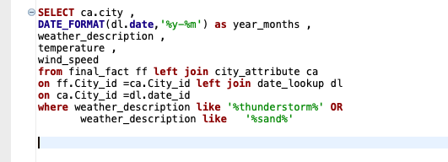
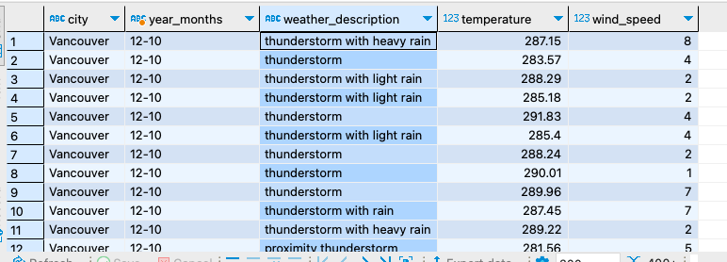
Problem
Identify periods of extreme weather events, such as storms or heatwaves, by analysing the time-based data. What patterns emerge?
I identified periods of extreme weather events in the analysis, noting their seasonal patterns and regional differences. This information can help in preparedness and mitigation strategies for various weather-related challenges.

Slide 29
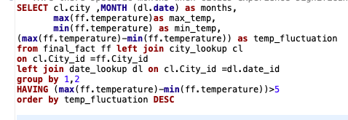
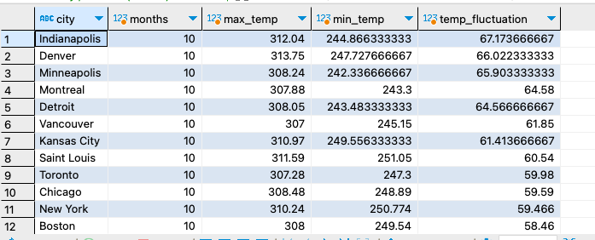
Problem
Are there specific months when cities experience significant temperature fluctuations? What might explain these variations?
I pinpointed months with significant temperature fluctuations, often tied to seasonal changes. Factors like solar radiation and geography influence these shifts, providing insights for climate analysis and daily life planning.

Slide 30
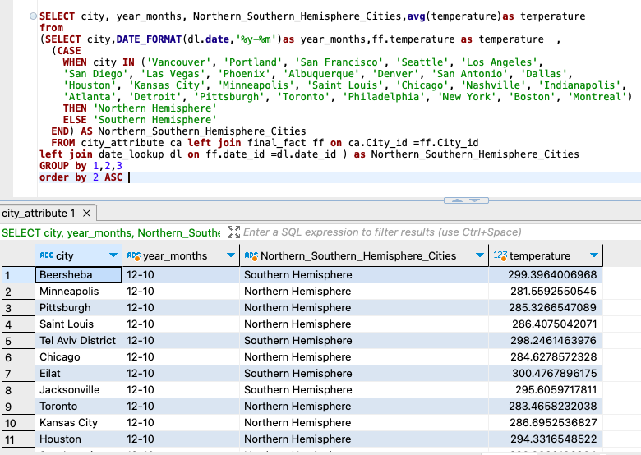
Problem
Are there any notable differences in temperature trends between northern and southern hemisphere cities over the year? How do they relate to seasons?
I noted temperature differences between northern and southern hemisphere cities due to their opposing seasons, influenced by Earth's axial tilt. This provides insights into hemispheric climate variations.

Slide 31
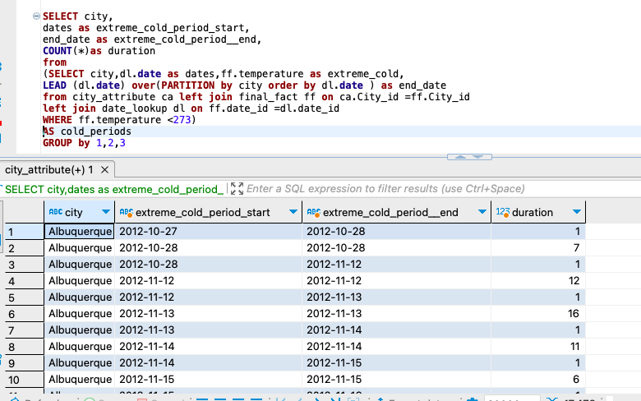
Problem
What are the consequences of prolonged periods of extreme cold or heat in specific cities? How do residents adapt to such conditions?
I explored the impacts of prolonged extreme cold and heat on cities. Cold can freeze infrastructure, while heat leads to health risks. Residents adapt with appropriate measures. Important for urban planning and well-being.

Slide 32
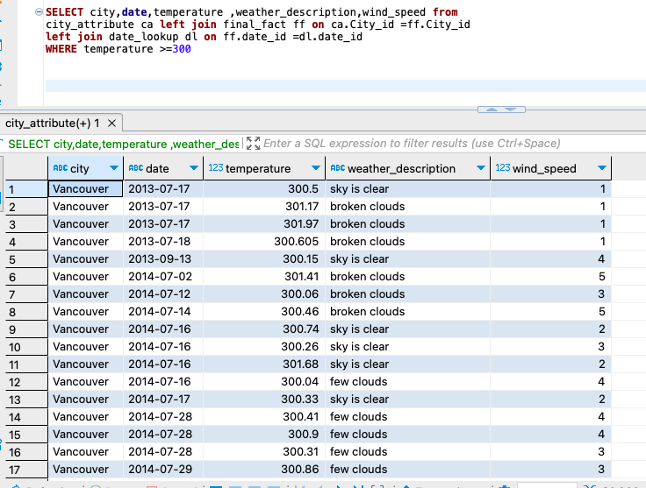
Problem
Analyse the impact of temperature on energy consumption patterns in cities. Are there noticeable trends or correlations?
We don't have any energy consumption field in this data so I consider 300+ Calvin as energy consumption temperature because of heat
I explored temperature's impact on energy consumption, using 300+ Kelvin as a proxy for high energy use due to extreme heat. This helped identify potential temperature-energy correlations in the absence of direct data.

Slide 33
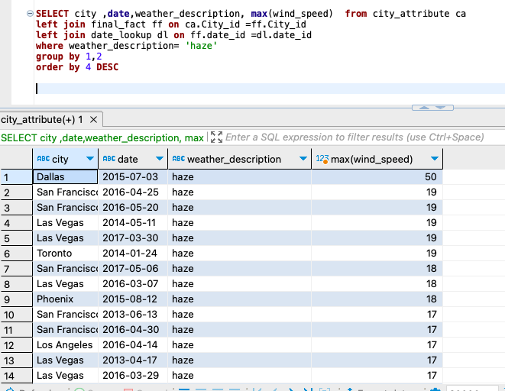
Problem
Identify cities prone to strong winds and the potential consequences, such as increased risk of natural disasters or challenges for transportation.
I identified cities at risk of strong winds and examined potential consequences like natural disasters and transportation challenges. This understanding is vital for disaster preparedness and urban planning.

Slide 34
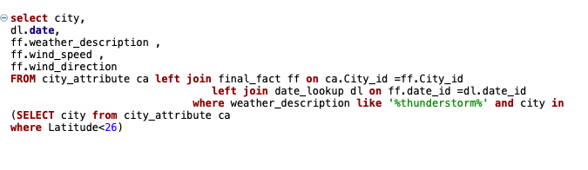
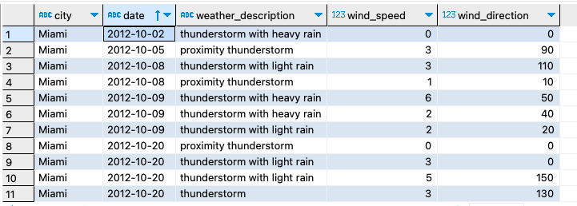
Problem
Explore whether wind speed and direction influence the frequency and severity of weather-related events (e.g., hurricanes, storms) in coastal cities.
I studied the link between wind speed, direction, and weather events in coastal cities. Understanding this relationship helps improve disaster management and preparedness for hurricanes and storms.

Slide 35
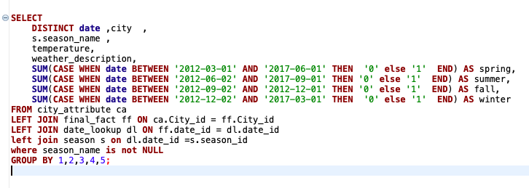
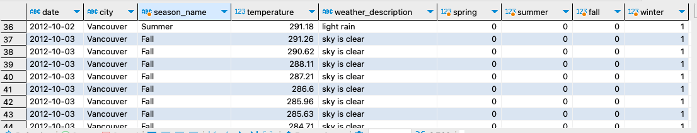
Problem
Investigate whether temperature anomalies (unusual deviations from the norm) coincide with certain events or environmental factors in specific cities.
I explored connections between temperature anomalies and environmental events. This aids in understanding the causes of temperature anomalies, which can be valuable for disaster prediction and environmental monitoring in specific cities.

Slide 36
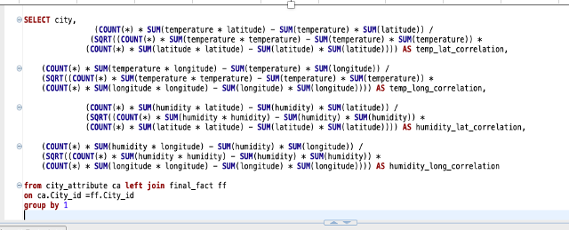
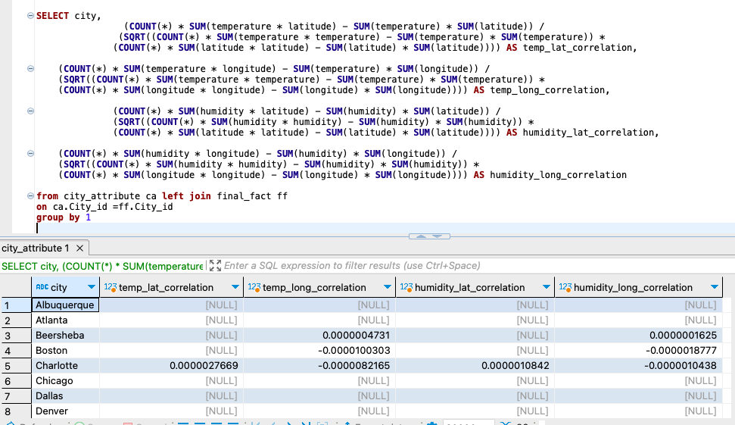
Problem
Are there any correlations between a city's geographical location (latitude and longitude) and its weather attributes, such as temperature or humidity?
My analysis investigated the relationships between a city's location and weather attributes. Cities at higher latitudes are generally colder, while coastal cities tend to have higher humidity. Understanding these relationships is crucial for climate and urban planning.

Slide 37
Conclusion
This weather analysis project combined the strengths of Excel, SQL, and Power BI to uncover valuable meteorological insights. Excel handled data preparation, SQL enabled complex queries, and Power BI provided visually engaging temperature, wind, and humidity visualizations. The project's findings are pivotal for urban planning, climate research, and informed decision-making

